Slide 1
IDEA/APPROACH DETAILS
TECHNOLOGY BUCKET: Software - Web App development CATEGORY: Software
COMPANY NAME/MINISTRY NAME: Maruti Suzuki India Ltd. PROBLEM CODE: NM1
TEAM LEADER: Clayton Sohan Pereira COLLEGE CODE: 1-3508330114

Slide 2
Information Gathering: An user will/can fill up a first hand report where the entire information of the accident will be documented. The report will include images and/or videos of the accident, interviews with the eyewitnesses, cause of the accident and the people involved in the accident.
User Authentication: The user can be a police officer, transport authorities or an ambulance personnel. If the user is an ordinary citizen he/she needs to authenticate himself/herself in to the system using a legal document- ID proof.
Settle the Dispute: If the accident is minor, the parties involved can gather information about each other including insurance numbers and its details. This will enable them to settle their dispute and will also be convenient for the insurance companies of the respective parties to look into the case.
Eyewitness Protection: The Details of the eyewitnesses will be kept private only to be accessed by any concerned official having the rights to access them.
Additional Evidence: In case of major accident this First Hand Report with images and videos can act as a evidence into the case, thus helping the authorities to investigate into the matter.
TECHNOLOGY STACK:
CLIENT-SIDE: 1] React Native Framework (Open source library)
2] Native Base UI Library (Open source framework)
SERVER-SIDE: 1] Express Framework (For Backend Business logic)
(Open Source Framework)
2] Mongo Database(For Storing user details)
(Open Source Database)
DESCRIPTION OF THE IDEA /SOLUTION/ PROTOTYPE

Slide 3
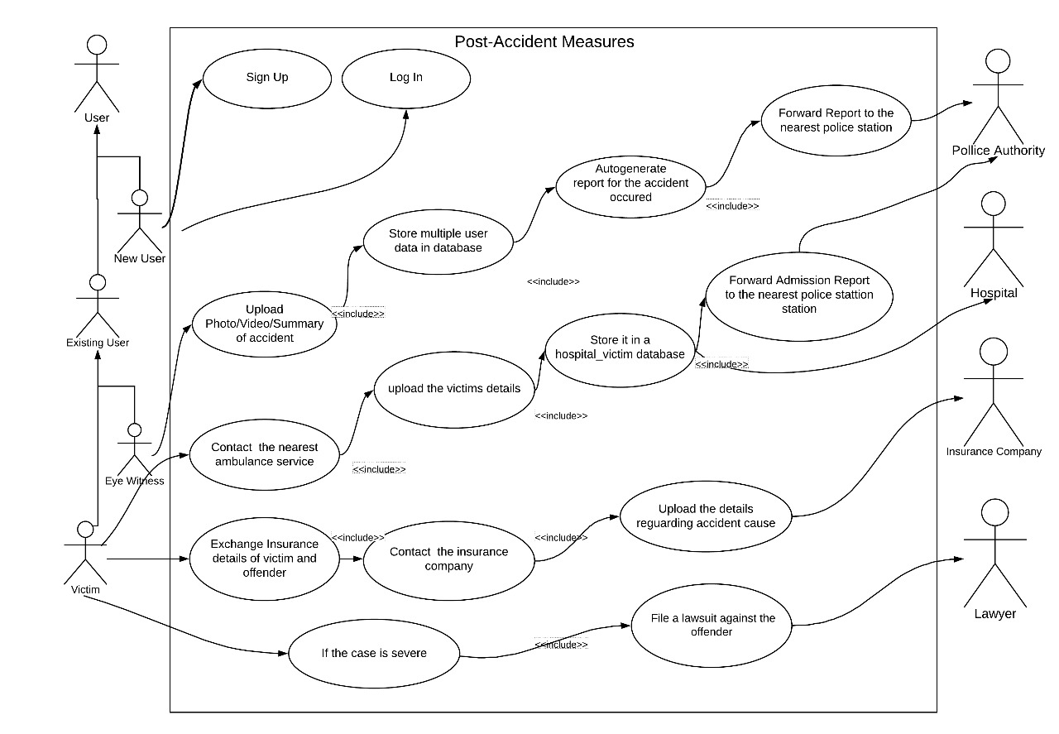
DESCRIPTION OF USE CASES: UML USE CASE DIAGRAM

Slide 4
SEQUENCE DIAGRAM

Slide 5
USERS:
The user can be a police officer, transport authorities or an ambulance personnel. If the user is an ordinary citizen he/she needs to authenticate himself/herself in to the system using a legal document- ID proof. The user can generate a FHR(First Hand Report) where he/she needs to document the details about the accident. The report will include images and/or videos of the accident, interviews with the eyewitnesses, cause of the accident and the people involved in the accident.
OFFICIALS:
Officials can be a police officer, transport authority or an ambulance personnel who also can document the report about the accident. The privilege to access the report will be only with concerned government official.
INSURANCE COMPANIES :
If the accident is minor, the parties involved can gather information about each other including insurance numbers and its details. This will enable them to settle their dispute and will also be convenient for the insurance companies of the respective parties to look into the case.
ADMIN:
Admin can manage all the activities on the app, i.e. approve/disapprove reports. Additionally admin has the right to activate/deactivate any user’s account in case of unethical activities.
DEPENDENCIES/SHOW STOPPER:
Report Authenticity :
It is difficult to identify false reports or to check whether the user has manipulated the report or not.
Eyewitness's Reluctant to Help :
People may not come forward to help filing the report or be the eyewitness due to the stigma that they may be harassed in future.

